Slide 1
CAPSTONE ON TRAFFIC VIOLATION PREDICTION
SUBMITTED BY,
JIBIN JONAH B

Slide 2
PROBLEM STATEMENT
To create a predictive model that accurately classifies traffic violations committed by drivers. This will involve analyzing historical data that includes various features such as the date and time of the traffic stop, the driver's demographic information, the type of violation, whether a search was conducted, and the outcome of the stop. The target variable in this model is the type of violation committed. The goal is to build a model that can accurately predict the type of violation based on the available features. The resulting model could be used by law enforcement agencies to identify areas for traffic enforcement and allocate resources more efficiently.

Slide 3
Target variable
The target variable "violation" has six levels or categories, namely: speeding, other, seatbelt, equipment, moving violation, and registration/plates.
Speeding: This category is used when a driver is found to be driving over the posted speed limit.
Other: This category is used when the violation does not fit into any of the other categories. For example, it could be used for things like illegal turns or driving in a bus lane.
Seatbelt: This category is used when a driver or passenger is not wearing a seatbelt.
Equipment: This category is used when a vehicle has a mechanical or electrical issue that renders it unsafe or non-compliant with regulations. For example, it could be used for a car with a broken taillight or no headlights.
Moving Violation: This category is used when a driver violates a traffic law that is related to how they are operating their vehicle. For example, it could be used for things like running a red light or making an illegal U-turn.
Registration/Plates: This category is used when there is an issue with the driver's registration or license plates. For example, it could be used for things like an expired registration or an illegible license plate.

Slide 4
METHODOLOGY
Collect historical traffic stop data that includes various features such as stop date and time, driver information, violation type, search conducted, and stop outcome.
Pre-process the data to clean, transform, and normalize the features as necessary. This may include handling missing data, converting categorical data into numerical features, and feature scaling.
Identify the most relevant features that will be used for prediction. This could be done through exploratory data analysis or using feature selection techniques.
Evaluate various machine learning algorithms and select the most suitable model for this problem. Some algorithms to consider include Decision Trees, Random Forests, and Support Vector Machines (SVM).

Slide 5
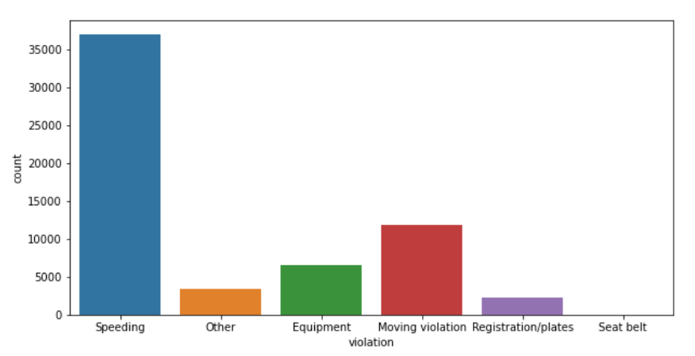
EDA
VIOLATION (target variable)

Slide 6
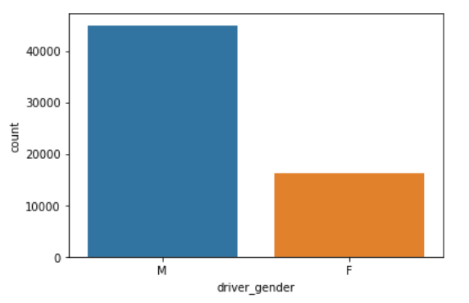
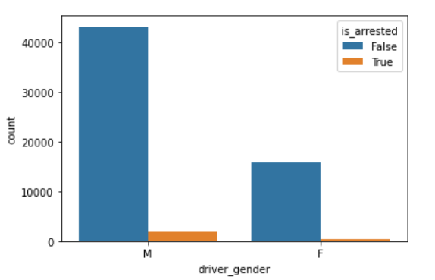
driver_gender

Slide 7
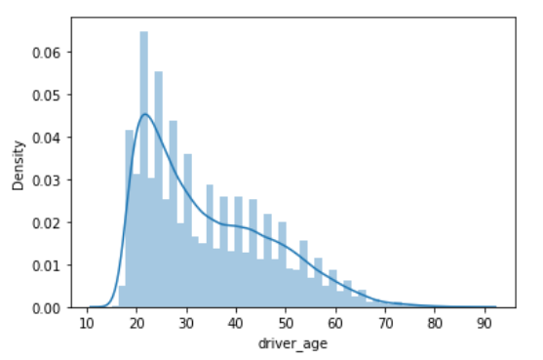
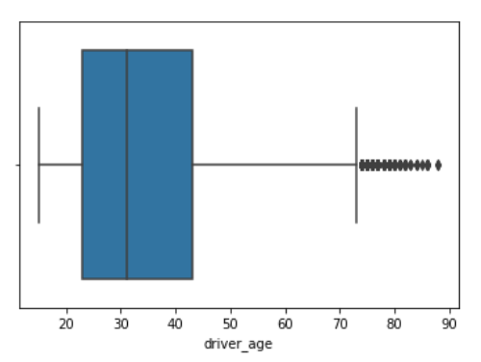
driver_age

Slide 8
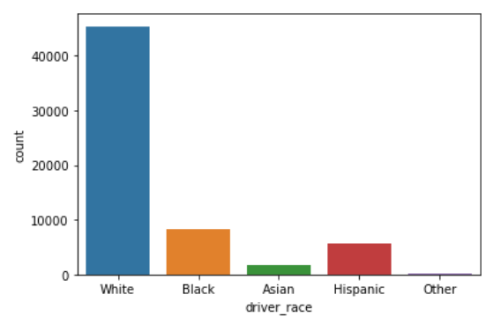
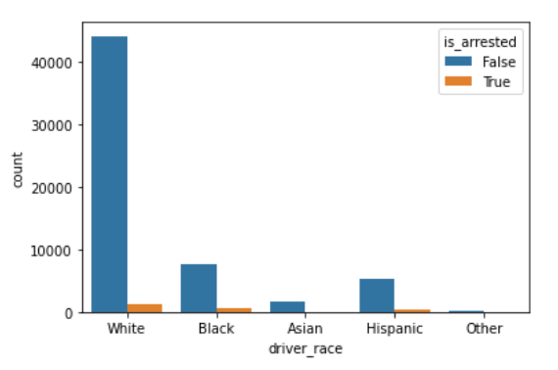
driver_race

Slide 9
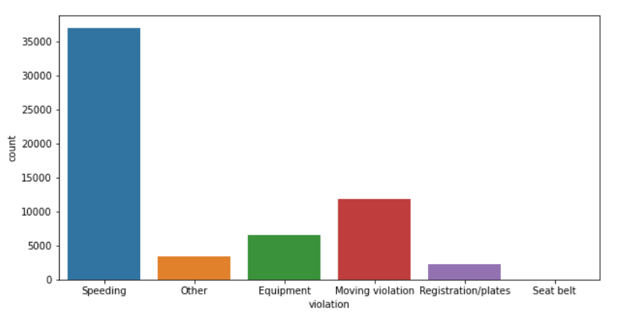
violation (target variable)

Slide 10
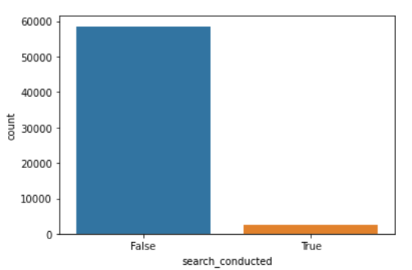
search_conducted

Slide 11
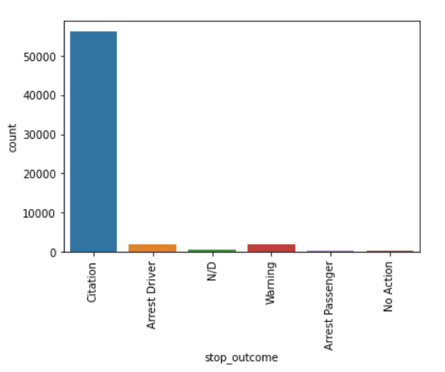
stop_outcome

Slide 12
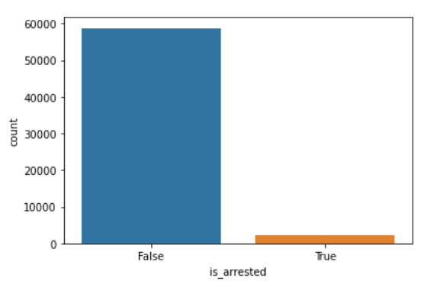
is_arrested

Slide 13
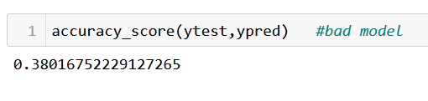
LOGISTIC REGRESSION

Slide 14

K NEAREST NEIGHBOR

Slide 15
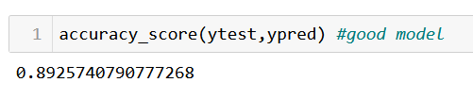
Decision tree

Slide 16
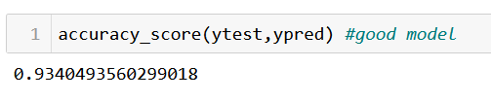
Random forest

Slide 17
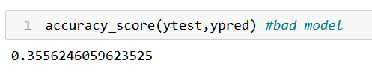
ADAboost

Slide 18
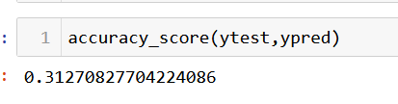
SVM

Slide 19
Key Findings
From the analysis we have done by creating various models we get to know which one is the best.
The accuracy we obtained on various models obtained by using different algorithms suggest that the Random Forest model is better.
It will be the right option to solve our business problem.

Slide 20
How helpful for business
Resource Allocation: The model can help businesses such as law enforcement agencies to allocate their resources more efficiently. By identifying areas where specific types of traffic violations are more likely to occur, businesses can prioritize their efforts and allocate their resources to those areas, resulting in more effective enforcement and safer roads.
Better Planning: By analyzing the data from the model, businesses can make more informed decisions about traffic planning and infrastructure. For example, if a certain type of violation is consistently occurring on a particular stretch of road, businesses can take steps to address the issue, such as installing additional signage or traffic lights.
Improved Safety: By identifying and addressing traffic violations more effectively, businesses can contribute to improving overall road safety. This can benefit not only the businesses themselves, but also the wider community, including drivers, passengers, and pedestrians.
Increased Revenue: In some cases, businesses may be able to generate revenue by issuing fines or penalties for traffic violations. By using the model to identify violations more accurately, businesses can increase their revenue stream and improve their bottom line.

